Slide 1

HMM for Bitcoin Price Prediction

Slide 2


Group 6
A0215662H Changjie Jin
A0209205N Ng Zhi Wei Aaron
A0129685N You Pengxin
A0140527M Chio Qi Jun
A0133910R Zhang Yuxi

Slide 3
Overview
Introduction to HMM
Data and Methodology
Results
Evaluation of Results

Slide 4
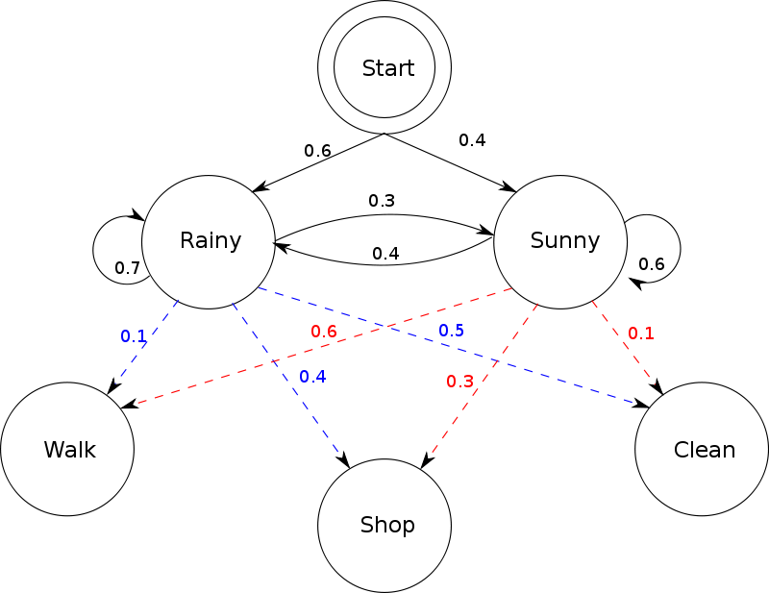
Introduction to Hidden Markov Model (HMM)
Hidden states
HMM is constructed based on a set of unobserved states (hidden states) and possible observations which are associated with the hidden states.
HMM's have been successful in analyzing and predicting time depending phenomena, or time series. Bitcoin historical price is a typical time series that HMM can be applied to.
Observations
https://www.cs.cmu.edu/~bdhingra/papers/stock_hmm.pdf

Slide 5
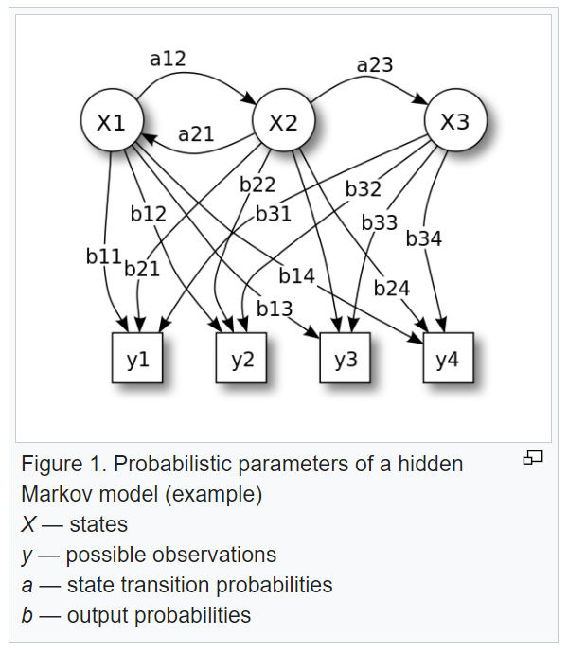
Theory
HMM assumes the observed data is generated by a sequence of hidden states.
The hidden states are assumed to follow a Markov chain, which is specified by the start probability vector π and a transition probability matrix A.
As our data is continuous, we assume the emission probability of the observation to follow a Gaussian distribution with parameters θ conditioned on the hidden states.
The HMM is completely determined by π, A and θ.

Slide 6
Three Fundamental Problems of HMM
Problem | Algorithm
1. Given the model parameters and observed data, estimate the optimal sequence of hidden states. | Viterbi algorithm
2. Given the model parameters and observed data, calculate the likelihood of the data. | Forward-Backward algorithm
3. Given just the observed data, estimate the model parameters. | Baum-Welch algorithm

Slide 7
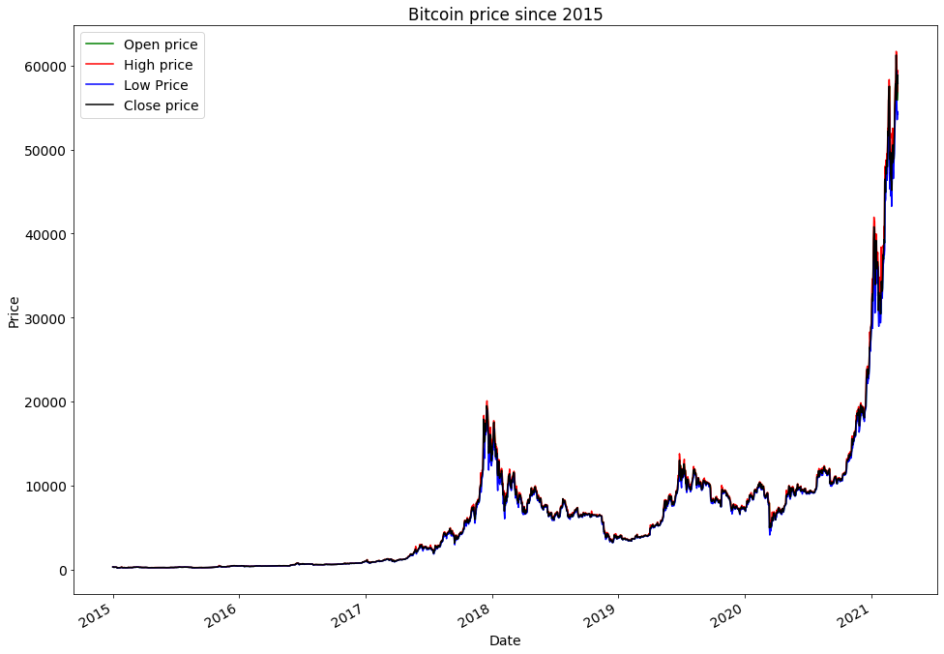
Data
We acquired the open, high, low and close Bitcoin price data from 1 Jan 2015 to 18 Mar 2021

Slide 8
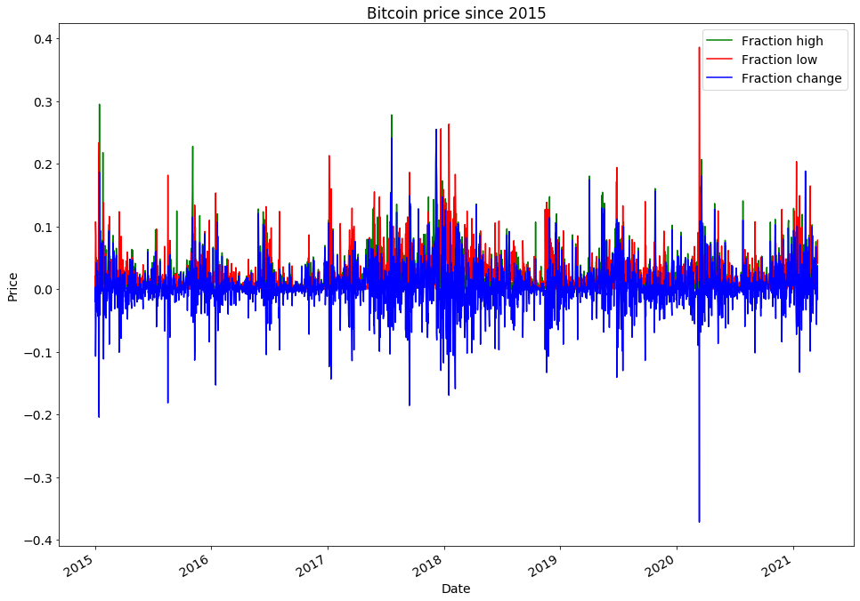

Methodology
$${frac}_{change}= \frac{close−open}{open}$$
$${frac}_{high}= \frac{high−open}{open}$$
$${frac}_{low}= \frac{open−low}{open}$$
$$predicted close=open∗(1+predicted {frac}_{change})$$
Rather than using the bitcoin price directly, we use the factional change in the close, high, and low price vs. the open price to train our HMM.
Firstly, we split the data into two subsets: the training set and testing set, with 34% data as training set and 66% as test set.
Then we train the HMM using the training set to compute the parameters. We set the number of hidden states to 3. Once the model is trained, we will use it to predict frac_change, which can be used to compute the predicted price.

Slide 9

Methodology
To predict frac_change, we focus on the data of the past k days (n_latency_days=k), and seek the find the value of X_(t+1) that maximizes the posterior probability on the right, where φ = (π, A, θ).
We can make use of the score function to calculate the log likelihood of observing the samples given the fitted model. For our model, we have set k = 10.
$$\left.X_{t+1}={argmax}_{X_{t+1}}P\left(X_{t+1} | X_{t−k+1},… , X_{t },ф\right)= {argmax}_{X_{t+1}}\frac{\left.P(X_{t−k+1},… , X_{t }, X_{t+1 },ф\right)}{\left.P(X_{t−k+1},… , X_{t },ф\right)}={argmax}_{X_{t+1}} P\left(X_{t−k+1},… , X_{t }, X_{t+1 }\right|ф)P(ф)={argmax}_{X_{t+1}} P\left(X_{t−k+1},… , X_{t }, X_{t+1 }\right|ф\right)$$

Slide 10
Methodology
Because X_(t+1 )is a continuous variable, we decide to discretize the possible range of values according to the table below.
With the discretization, we can proceed to find the optimal X_(t+1 )
Observation | Minimum | Maximum | Number of points
frac_change | -0.1 | 0.1 | 50
frac_high | 0 | 0.1 | 5
frac_low | 0 | 0.1 | 15

Slide 11
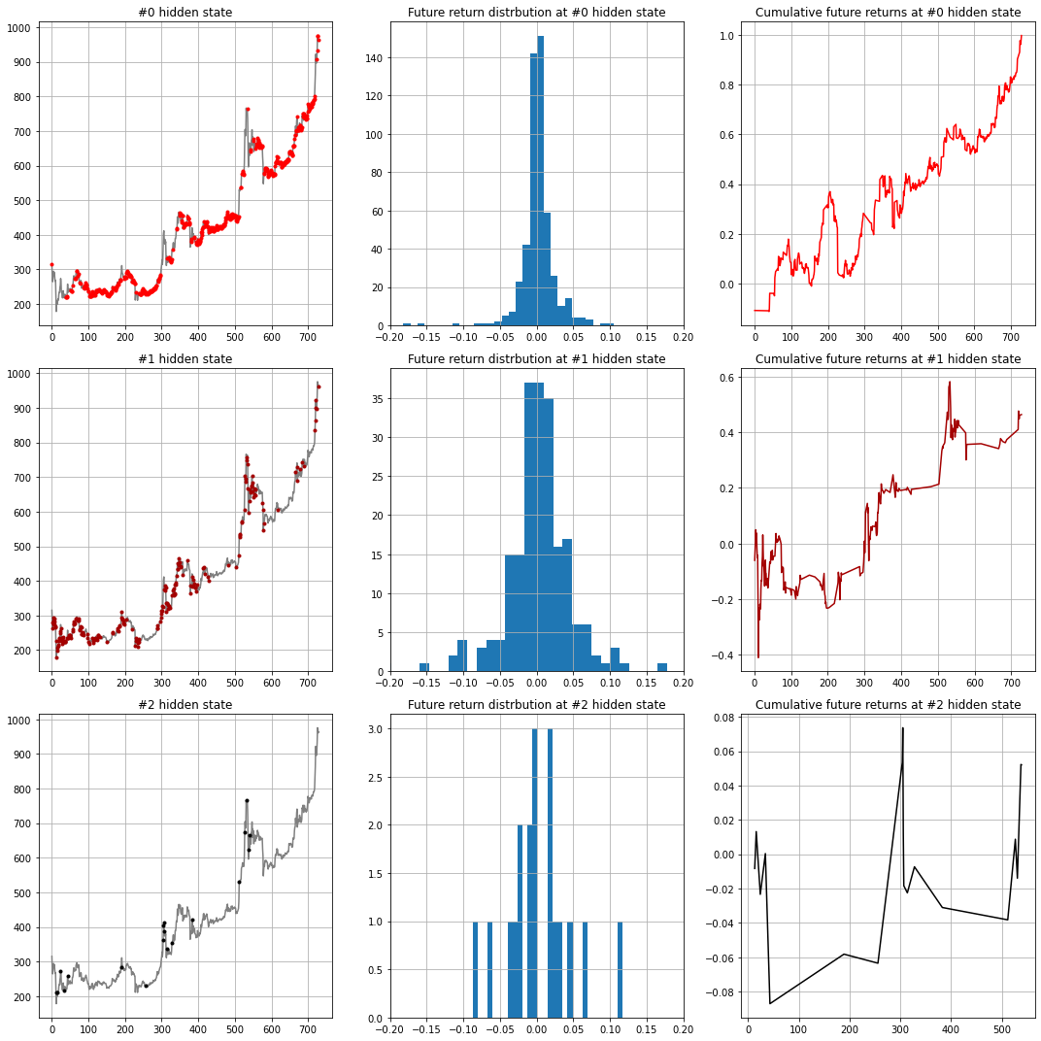
Results – State plot for in-sample data
We proceed to analyze the states by plotting each state against the respective price charts as well plotting their return distributions and cumulative future returns for each state
State 0: Price plot for this state is skewed towards a bullish state as can be seen that the states typically correspond to bullish trends in price with overall best future returns. We can thus define this state as bullish. Interesting to observe as well that returns distributions are narrow which shows relative consistency across the state
State 1: The price plot for hidden state 1 is somewhat unclear with regards to interpretation with a wide returns distribution. Thus we can label this state as random
State 2: From the first hidden state price plot, we see some areas of tops spotted but values are sparse. Possible interpretation: Signal market turns
Overall, given that the price in our training set is generally bullish hence it makes sense that the bullish state 0 has a much larger data set

Slide 12
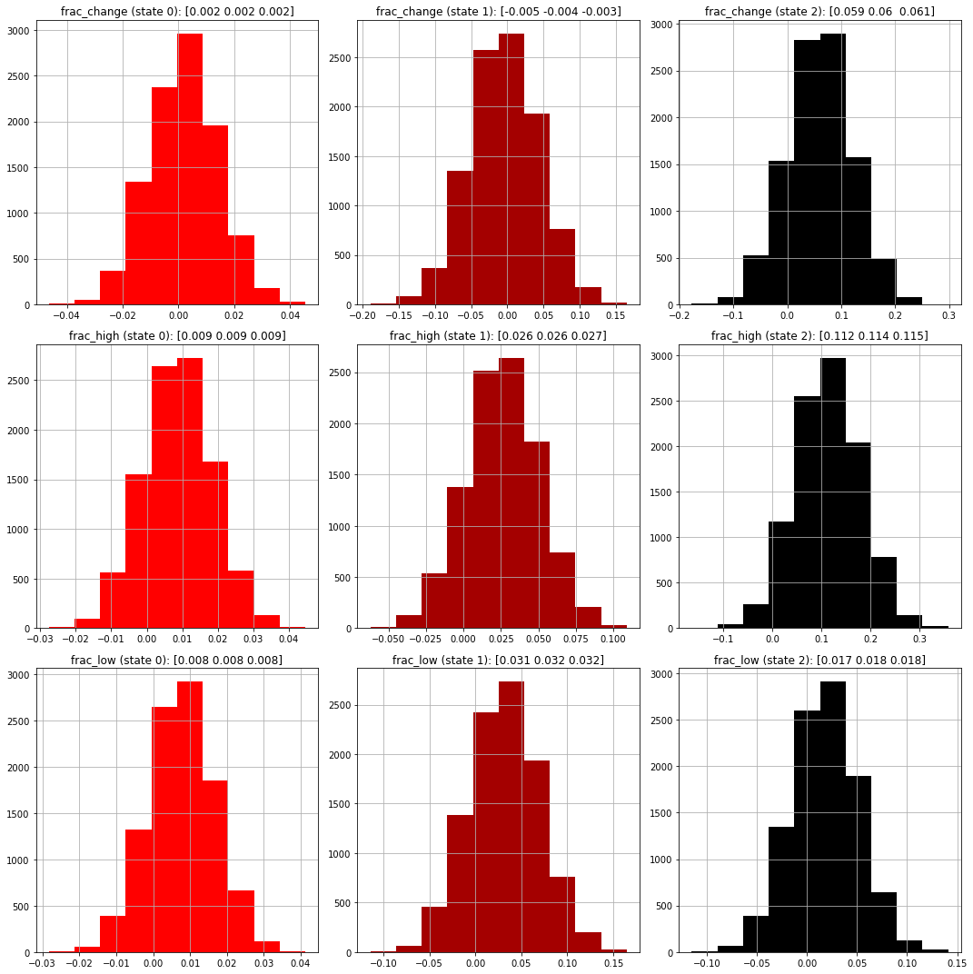
Results – Features analysis for each state
Further analysis on the features we used for our HMM model and its respective states. We run the model across 10,000 simulations to generate sample features across the different states
Frac_change: We see narrower distributions for state 0 with more positive values given it is a bullish state. State 1 has a wider distribution and lastly State 2 is sparse. Distributions are similar to our previous returns distribution
Frac_high: Slightly narrower distributions here in both state 0 and state 1 which could mean tighter high-to-open changes across states
Frac_low: Similar distributions to frac_high which could indicate that both high and low changes relative to price have similar characteristics in distribution

Slide 13
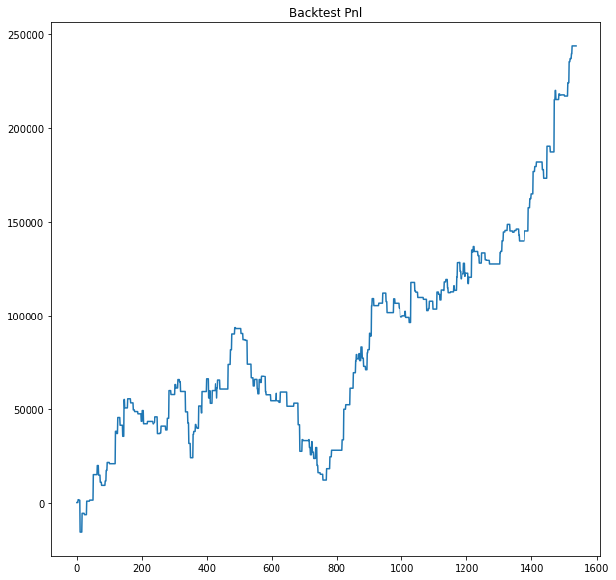
Results – Backtest on OOS data
After analysis of our states, we will run out model on our out-of-sample data and run a backtest to see the performance of our evaluation
For backtesting, we will go long for if model predicted state = 0 (bullish). Short if state = 2 (market turning). Close positions if state = 1 (random)
Position sizing is $100,000 / trade
Results of the backtest can be seen in the chart. Overall generating a return in excess of $200,000 or 200% over a 4 year period. Note that transaction costs and slippage are not included here

Slide 14
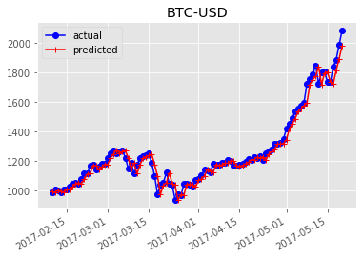
Results – Prediction
We used our HMM to predict the bitcoin prices for the next 100 days, and compares it with the actual price.

Slide 15
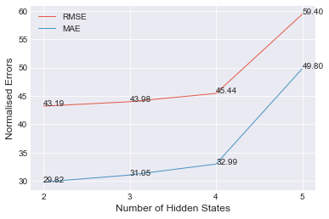
Evaluation – Prediction Errors
We used root mean square error (RMSE) and mean error to gauge the accuracy of our Hidden Markov Model.
RMSE ranged from 43.19 (2 states) to 59.40 (5 states)
Mean Error ranged from 29.82 (2 states) to 49.80 (5 states)

Slide 16
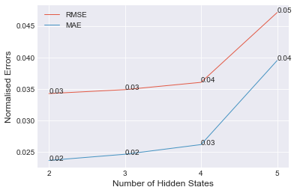
Evaluation – Prediction Errors
We use normalized errors to have a better visualization of our errors

Slide 17
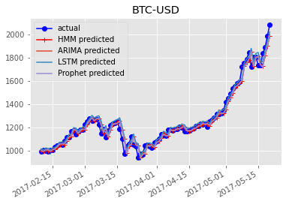
Evaluation – Comparison with Other Methods
We use RMSE and ME to compare our 3-state HMM model with a various models on 100 days.
RMSE and ME are calculated from predicted close price from only “frac_change” prediction.
ARIMA and Prophet are set 1 latency day , HMM & LSTM are set10 latency days ,and LSTM is set in the simplest form.

Slide 18
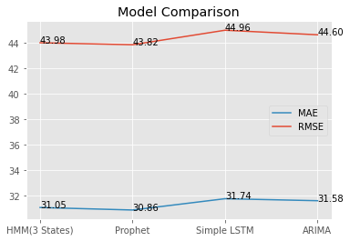
Evaluation – Comparison with Other Methods
We use RMSE and ME to compare our 3-state HMM model with a various models on 100 days.
RMSE and ME are calculated from predicted close price from only “frac_change” prediction.
ARIMA and Prohphet are set 1 latency day , HMM & LSTM are set10 latency days ,and LSTM is set in the simplest form.

Slide 19
Conclusion
HMM has some ability to distinguish between the different market regimes, with State 0 being the most bullish state. Potential trading strategy can be designed based on HMM.
However, in terms of prediction, HMM does not seem to capture large up or down moves and the predicted results looked “lagged”.
By comparing the prediction errors across different number of hidden states, 3 as the number of states is a reasonable choice.
Prediction results are comparable with a few other methods (slightly outperformed simple LSTM and ARIMA, and slightly underperformed Prophet.)

Slide 20

Thank you
Presenter: Group 6

